Slide 1
HNDIT1032 Computer and Network Systems
Week 12- Data Communication & Computer Network

Slide 2
Introduction
This chapter provides an introduction to Computer networks and covers fundamental topics like data, information to the definition of communication and computer networks.
The main objective of data communication and networking is to enable seamless exchange of data between any two points in the world.

Slide 3
Data Communications
Data Communication is a process of exchanging data or information In case of computer networks this exchange is done between two devices over a transmission medium.
This process involves a communication system which is made up of hardware and software.

Slide 4
Characteristic of Data Communication
The effectiveness of any data communications system depends upon the following three fundamental characteristics
Delivery
Accuracy
Timeliness
Jitter

Slide 5
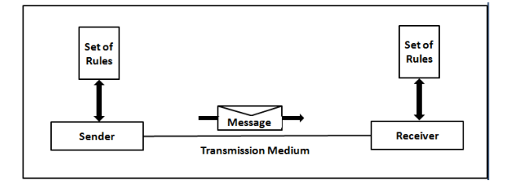
Components of Data Communication
Message
Sender
Receiver
Medium
Protocol

Slide 6
Data Flow
Two devices communicate with each other by sending and receiving data. The data can flow between the two devices in the following ways.
Simplex
Half Duplex
Full Duplex

Slide 7
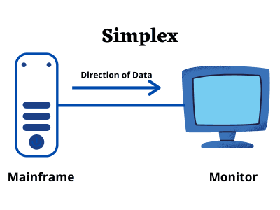
Simplex
In Simplex, communication is unidirectional Only one of the devices sends the data and the other one only receives the data.
Example: in the above diagram: a cpu send data while a monitor only receives data.

Slide 8
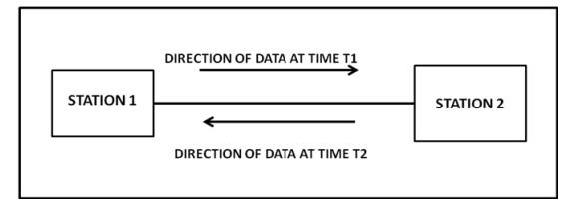
Half Duplex
In half duplex both the stations can transmit as well as receive but not at the same time.
When one device is sending other can only receive and vice versa (as shown in figure above.) Example: A walkie-talkie.

Slide 9
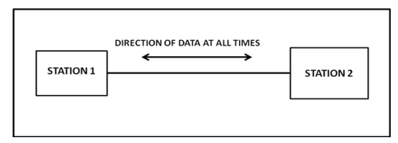
Full Duplex
In Full duplex mode, both stations can transmit and receive at the same time.
Example: mobile phones

Slide 10
Computer Network
A computer network can be defined as a collection of nodes.
A node can be any device capable of transmitting or receiving data.
The communicating nodes have to be connected by communication links.
Computer Networks are used for data communications.

Slide 11
Categories of Network
Networks are categorized on the basis of their size. The three basic categories of computer networks are:
Local Area Network (LAN)
Metropolitan Area Network (MAN)
Wide Area Network (WAN).

Slide 12
Local Area Network
LAN connects computers in a small area like a room, building, office or a campus spread up to a few kilometers.
They are privately owned networks, with a purpose to share resources and to exchange information.
The computers in a LAN are generally connected using cables.

Slide 13
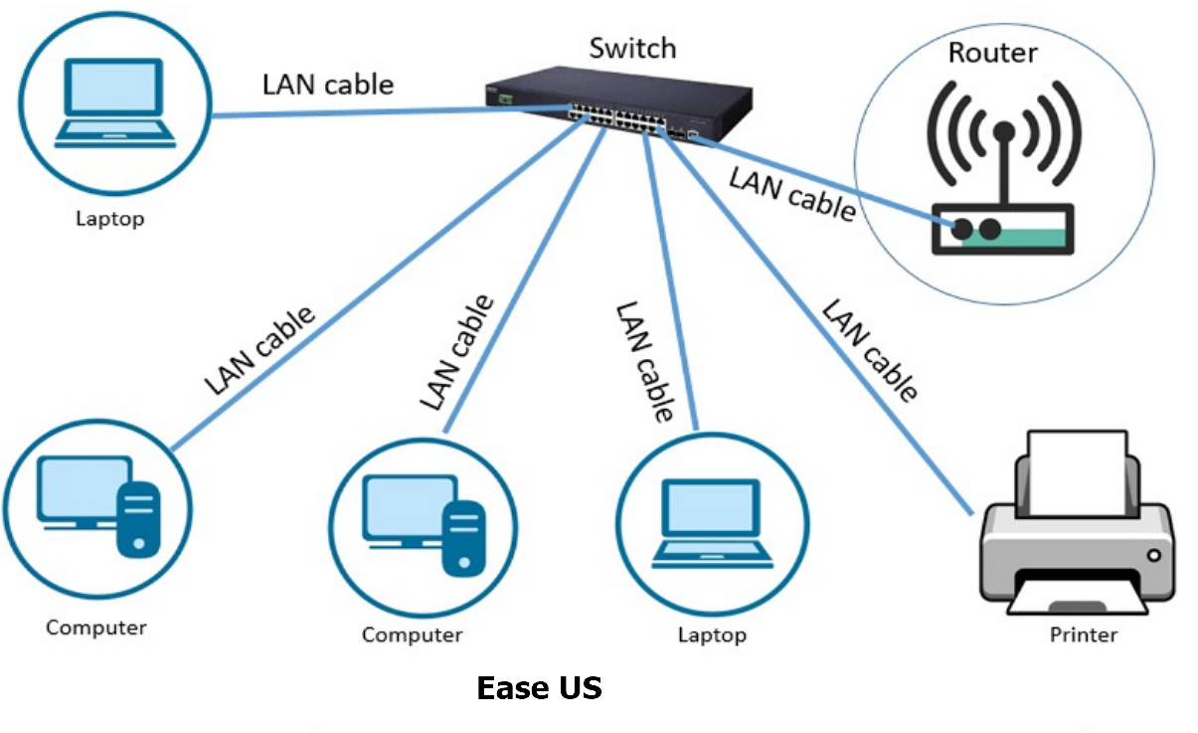
Example-LAN

Slide 14
Wide Area Network
WAN is a network that connects computers over long distances like cities, countries, continents, or worldwide .
WAN uses public, leased, or private communication links to spread over long distances.
WAN uses telephone lines, satellite link, and radio link to connect.

Slide 15
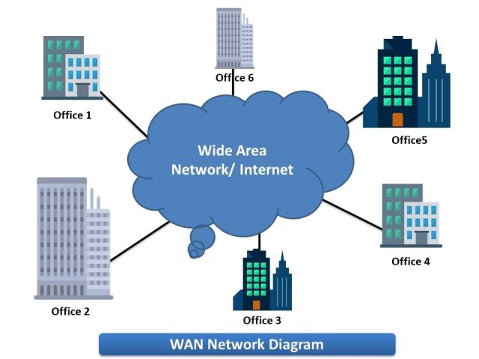
Example-WAN

Slide 16
Metropolitan Area Network
MAN is a computer network spread over a city. Cable television network is an example of MAN.
The computers in a MAN are connected using coaxial cables or fiber optic cables.
MAN also connects several LAN spread over a city

Slide 17
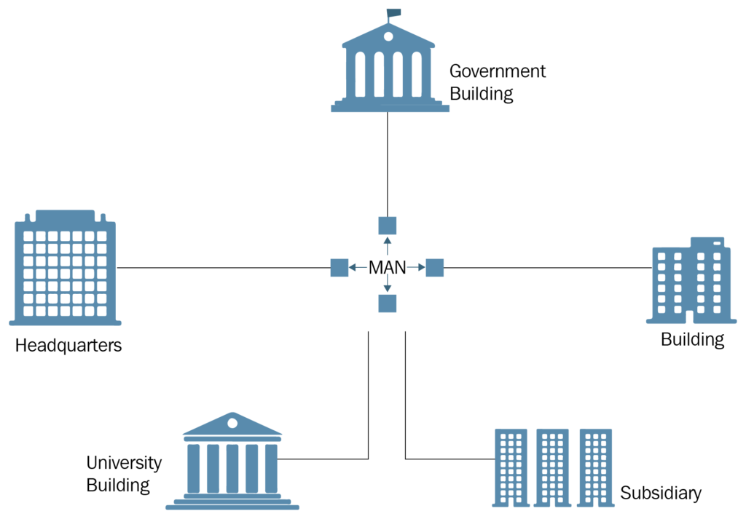
Example-MAN

Slide 18
Advantages of Computer Networks
Central usage of data
Anyone can connect
Data Sharing
Flexible
Reliable

Slide 19
Disadvantages
Cost of network
Virus and malware
Robustness
Lack of indepence

Slide 20
Data & Signal
To be transmitted, data must be transformed to electromagnetic signals.
Signal can be
Analog
Digital

Slide 21
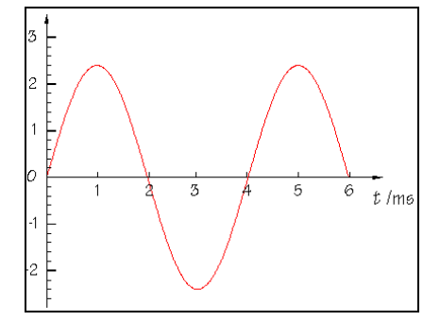
Analog Signal
An analog signal has infinitely many levels of intensity over a period of time.
A simple analog signal is a sine wave that cannot be further decomposed into simpler signals.

Slide 22
Characteristic of Analog Signal
A sine wave is characterized by three parameters:
Peak Amplitude
Frequency
Phase

Slide 23
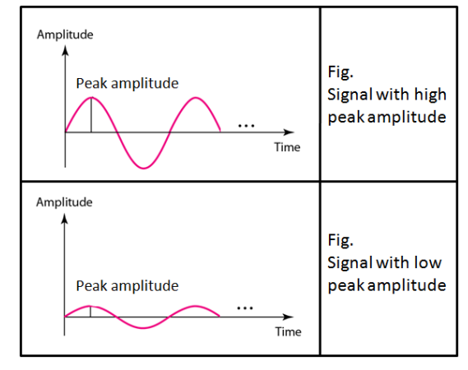
Peak Amplitude

Slide 24
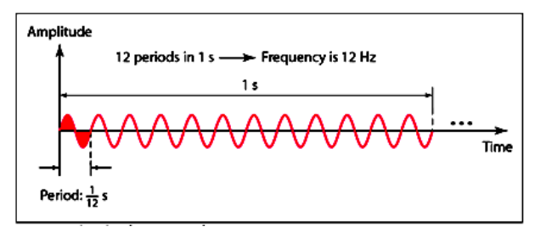
Frequency
Frequency refers to the number of cycles completed by the wave in one second.
Period refers to the time taken by the wave to complete one second.

Slide 25
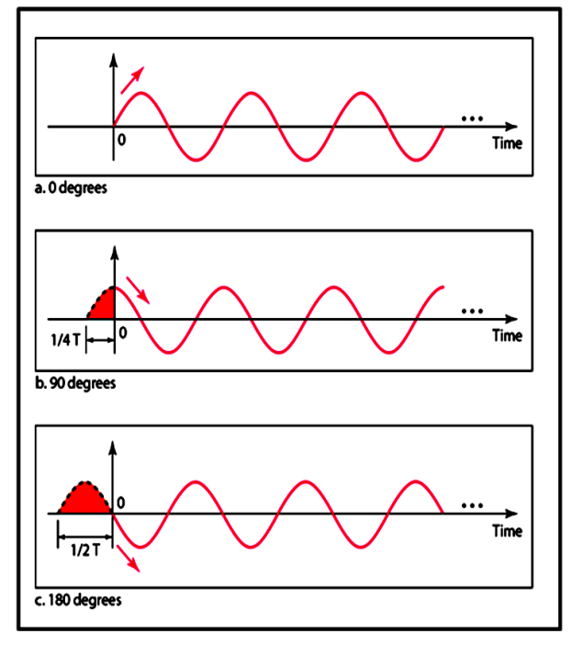
Phase

Slide 26
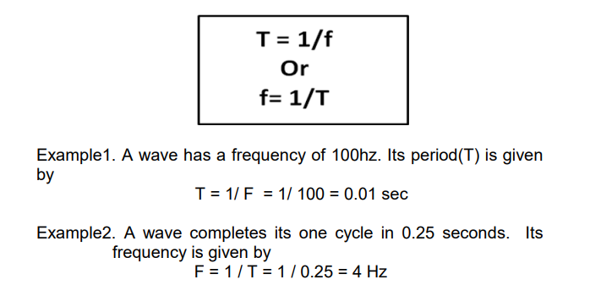
Relation between Frequency & Period

Slide 27

Wavelength
The wavelength of a signal refers to the relationship between frequency (or period) and propagation speed of the wave through a medium.
The wavelength is the distance a signal travels in one period.

Slide 28
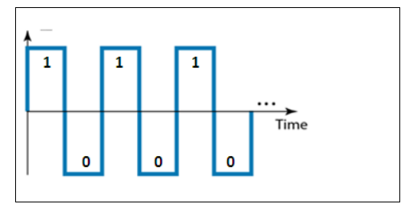
Digital Signal
A digital is a signal that has discrete values.
The signal will have value that is not continuous.
Information in a digital signal can be represented in the form of voltage levels.

Slide 29
Bit Interval
It is the time required to send one bit.
It is measured in seconds

Slide 30

Bit Rate
It is the number of bits transmitted in one second.
It is expressed as bits per second (bps).
Relation between bit rate and bit interval can be as follows.

Slide 31
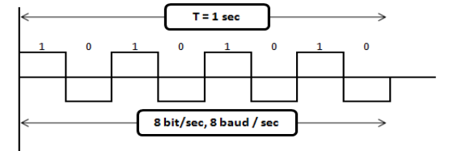
Baud Rate
It is the rate of Signal Speed, i.e the rate at which the signal changes.
A digital signal with two levels ‗0‘ & ‗1‘ will have the same baud rate and bit rate & bit rate.

Slide 32
Transmission of Digital Signal
Baseband Transmission-The signal is transmitted without making any change to it (ie. Without modulation)
Broadband Transmission-In broadband transmission we use modulation, i.e we change the signal to analog signal before transmitting it

Slide 33
Bandwidth of a Signal
Bandwidth can be defined as the portion of the electromagnetic spectrum occupied by the signal.
It may also be defined as the frequency range over which a signal is transmitted.

Slide 34
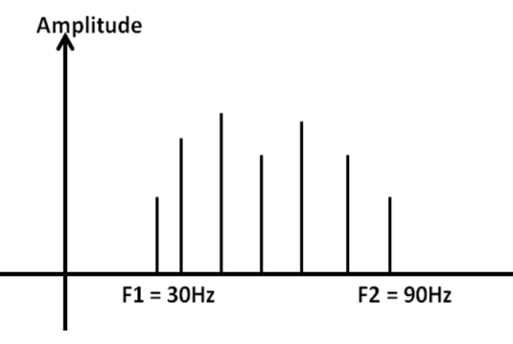

Example-Bandwidth

Slide 35
References
Clements, A., The Principles of Computer Hardware, Oxford University Press (4th Ed), 2006.

